Slide 1

Cricket Data Hub

Slide 2

ABSTRACT
This project, "Cricket Data Hub," is designed to efficiently manage and analyze cricket data using a structured SQL database. It encompasses key entities such as players, teams, matches, performances, and sponsors, each with specific attributes to capture comprehensive details.

Slide 3
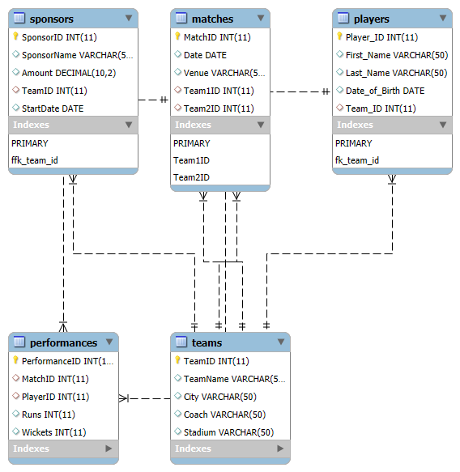
ER- DIAGRAM

Slide 4
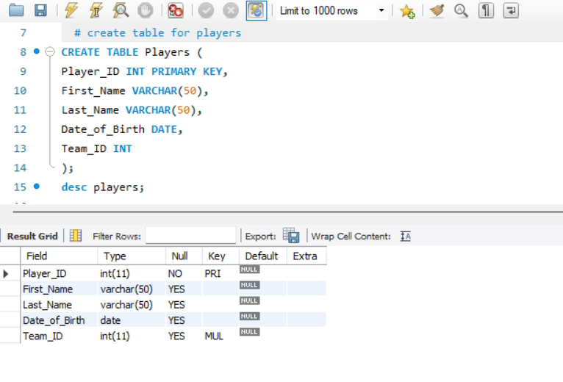
STRUCTURE OF TABLE
PLAYERS TABLE
The Players table stores essential information about cricket players.
Each record uniquely identifies a player through a
Player_ID (Primary Key).
It includes the player's First_Name, Last_Name, and Date_of_Birth to capture personal details.
The Team_ID (Foreign Key) establishes a relationship with the Teams table, indicating which team the player belongs to.
SYNTAX :- DESC PLAYERS;

Slide 5
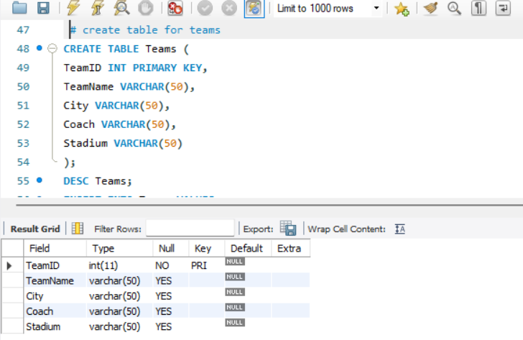
STRUCTURE OF TABLE
TEAMS TABLE:
The Teams table holds detailed information about cricket teams.
Each team is uniquely identified by a TeamID (Primary Key).
The table includes attributes such as TeamName for the team's name, City indicating the team's location,
Coach specifying the coach's name, and Stadium for the team's home ground.
SYANTAX :- DESC TEAMS;

Slide 6
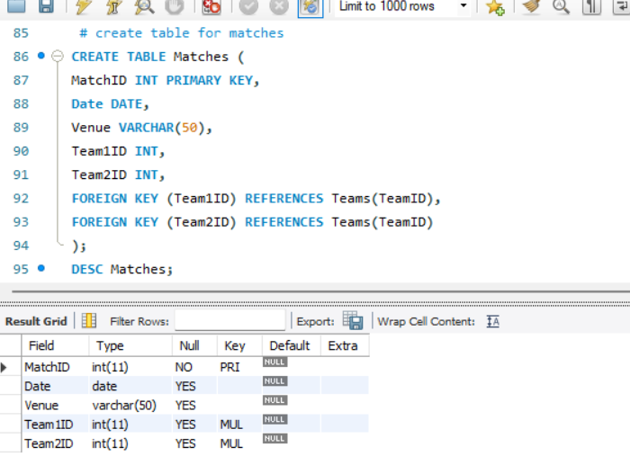
STRUCTURE OF TABLE
Matches Table:
The Matches table records the details of cricket matches.
Each match is uniquely identified by a MatchID (Primary Key).
The table includes attributes such as Date for the match date, Venue for the location where the match is played,
and Team1ID and Team2ID (both Foreign Keys) to specify the teams participating in the match.
SYANTAX:- DESC MATCHES;

Slide 7
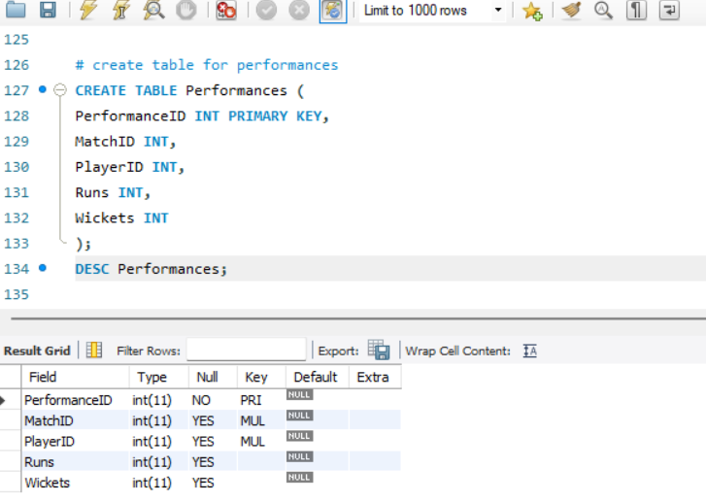
STRUCTURE OF TABLE
PERFORMANCES TABLE:
The Performances table captures individual player performances in cricket matches.
Each performance is uniquely identified by PerformanceID (Primary Key).
The table includes attributes such as MatchID (Foreign Key) to link to the match in which the performance occurred,
PlayerID (Foreign Key) to identify the player, Runs to record the number of runs scored by the player, and
Wickets to record the number of wickets taken by the player.
SYANTAX :- DESC PERFORMANCES

Slide 8
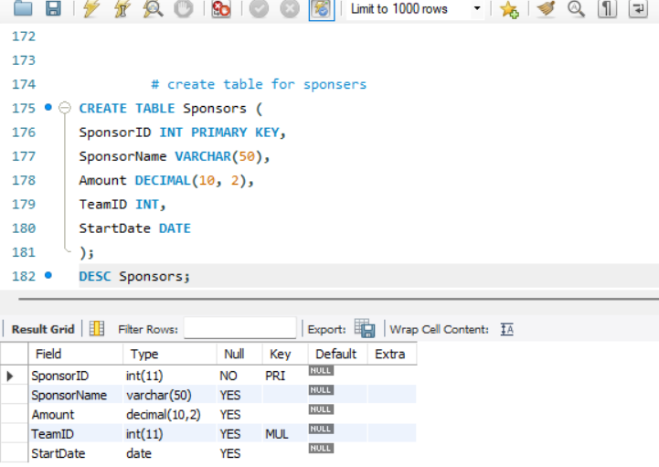
STRUCTURE OF TABLE
SPONSORS TABLE:
The Sponsors table records sponsorship details for cricket teams.
Each sponsor entry is uniquely identified by SponsorID (Primary Key).
The table includes attributes such as SponsorName to identify the sponsor, Amount to record the sponsorship amount,
TeamID (Foreign Key) to link the sponsor to a specific team, and StartDate to indicate the beginning of the sponsorship period.
SYANTAX:- DESC SPONSORS;

Slide 9
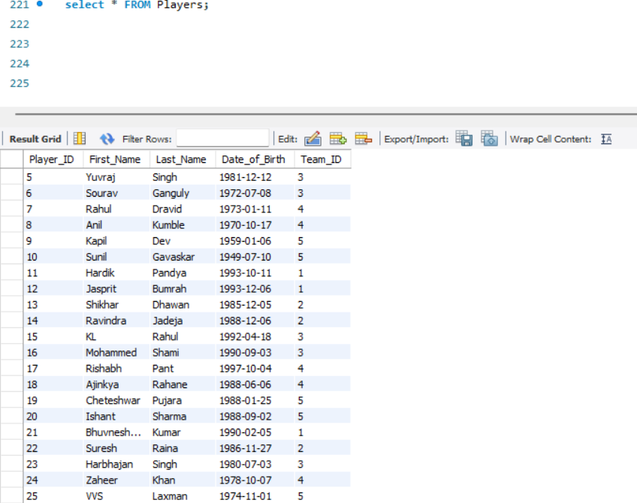
CONTENTS OF TABLE

Slide 10
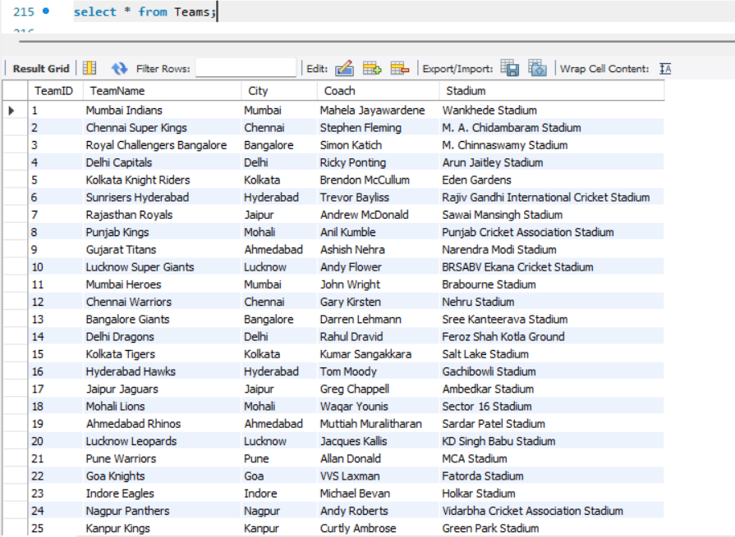
CONTENTS OF TABLE

Slide 11
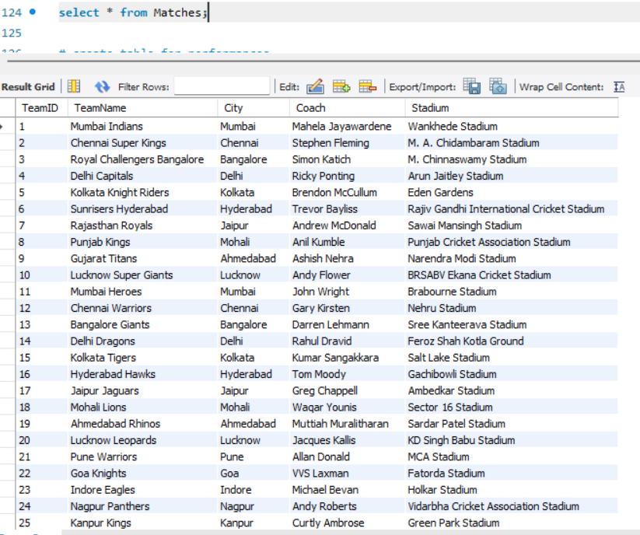
CONTENTS OF TABLE

Slide 12
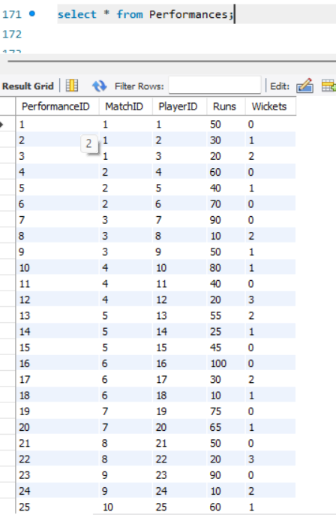
CONTENTS OF TABLE

Slide 13
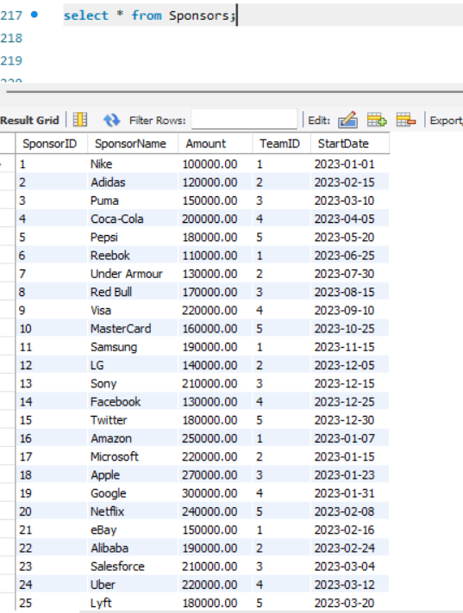
CONTENTS OF TABLE

Slide 14

SUB QUERIES

Slide 15
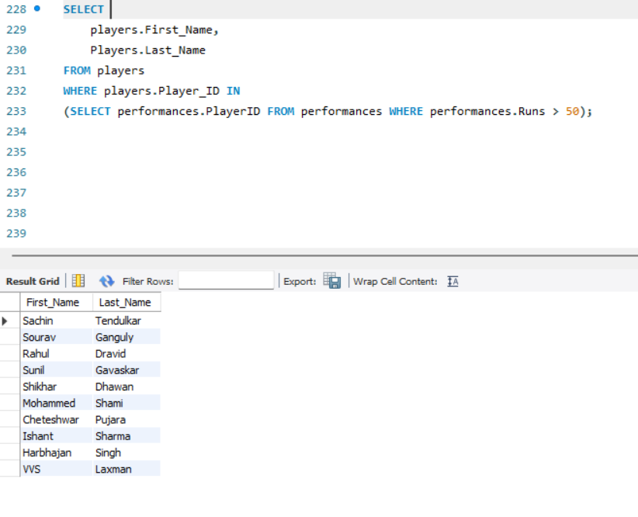
SUBQUERY
Display the names of players who have scored more than 50 runs in any match:
SYANTAX:SELECT players.First_Name, Players.Last_NameFROM players WHERE players.Player_ID IN (SELECT performances.PlayerID FROM performances WHERE performances.Runs > 50);

Slide 16
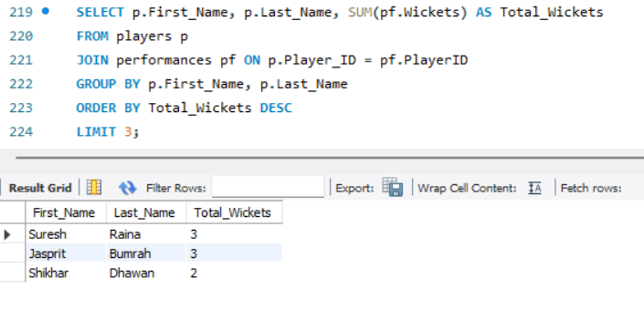
SUBQUERY
DISPLAY TOP 3 WICKET TAKING BOWLERS
SYANTAX:SELECT p.First_Name, p.Last_Name, SUM(pf.Wickets) AS Total_Wickets
FROM players p
JOIN performances pf ON p.Player_ID = pf.PlayerID
GROUP BY p.First_Name, p.Last_Name
ORDER BY Total_Wickets DESC
LIMIT 3;

Slide 17
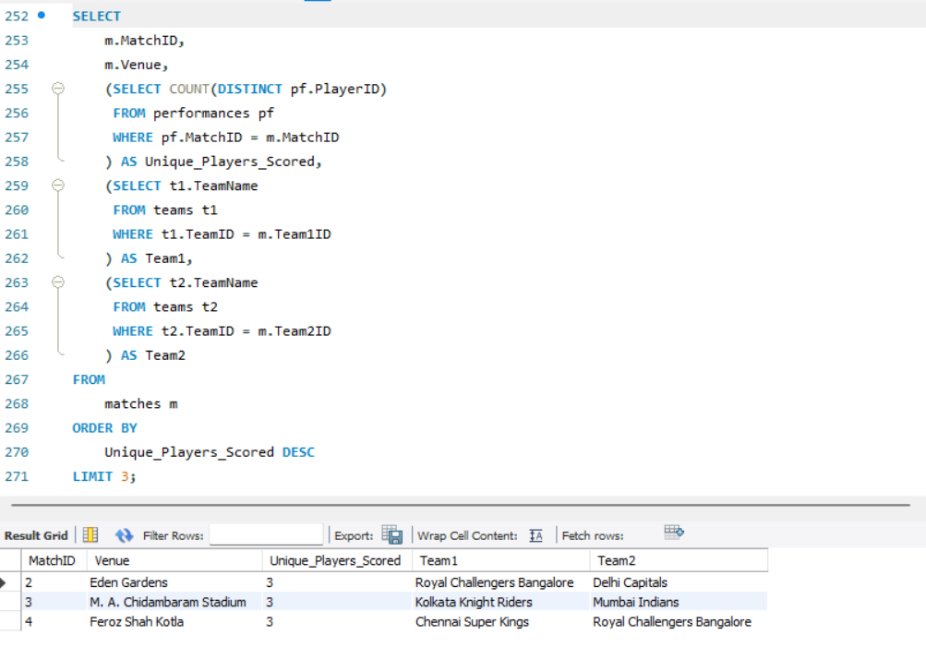
SUBQUERY
Display the top 3 matches where the highest number of different players scored runs and the teams involved.
SYANTAX:SELECT m.MatchID,m.Venue,
(SELECT COUNT(DISTINCT pf.PlayerID) FROM performances
WHERE pf.MatchID = m.MatchID) AS Unique_Players_Scored,
(SELECT t1.TeamName FROM teams t1
WHERE t1.TeamID = m.Team1ID) AS Team1,
(SELECT t2.TeamName FROM teams t2
WHERE t2.TeamID = m.Team2ID) AS Team2
FROM matches m
ORDER BY Unique_Players_Scored DESC
LIMIT 3;

Slide 18
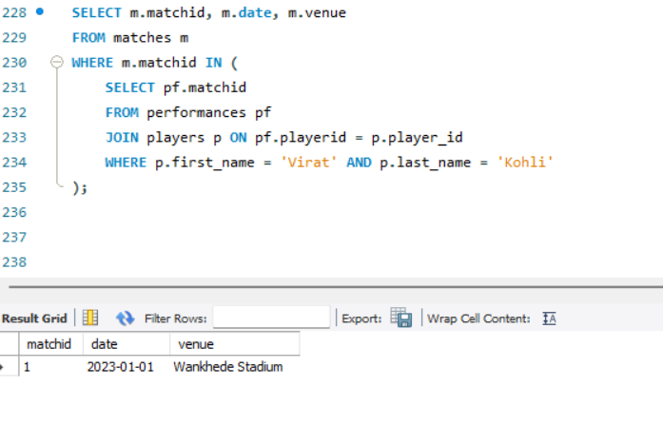
SUBQUERY
Display all matches in which a specific player, such as 'Virat Kohli', participated.
SYANTAX:- SELECT m.matchid, m.date, m.venue
FROM matches m
WHERE m.matchid IN (
SELECT pf.matchid
FROM performances pf
JOIN players p ON pf.playerid = p.player_id
WHERE p.first_name = 'Virat' AND p.last_name = 'Kohli');
18

Slide 19

JOINS

Slide 20
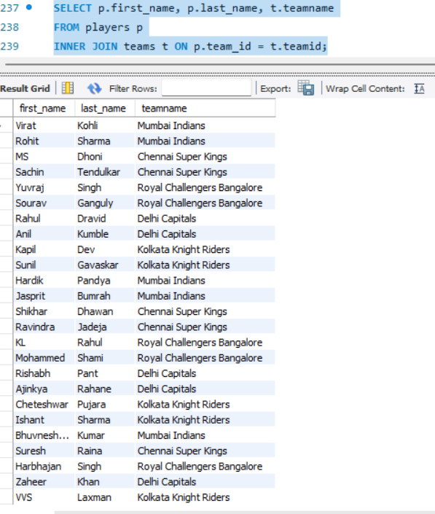
JOINS
Display players along with their respective teams.
SYANTAX:- SELECT p.first_name, p.last_name, t.teamname
FROM players p
INNER JOIN teams t ON p.team_id = t.teamid;

Slide 21
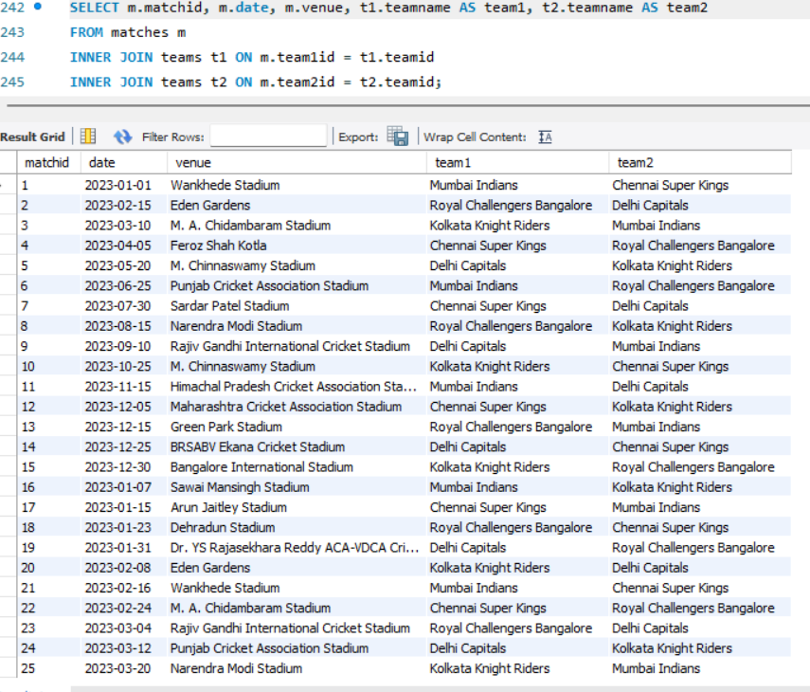
JOINS
Display matches with their respective venues.
SYANTAX:- SELECT m.matchid, m.date, m.venue, t1.teamname AS team1, t2.teamname AS team2
FROM matches m
INNER JOIN teams t1 ON m.team1id = t1.teamid
INNER JOIN teams t2 ON m.team2id = t2.teamid;

Slide 22
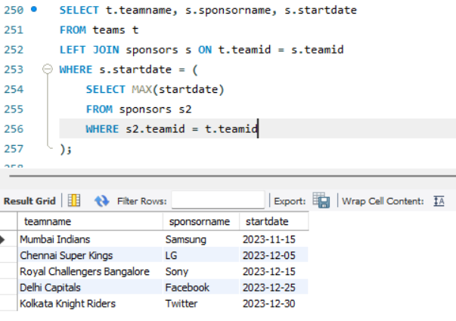
JOINS
Display all teams along with their most recent sponsor.
SYANTAX:- SELECT t.teamname, s.sponsorname, s.startdate
FROM teams t
LEFT JOIN sponsors s ON
t.teamid = s.teamid
WHERE s.startdate = (
SELECT MAX(startdate)
FROM sponsors s2
WHERE s2.teamid = t.teamid
);

Slide 23
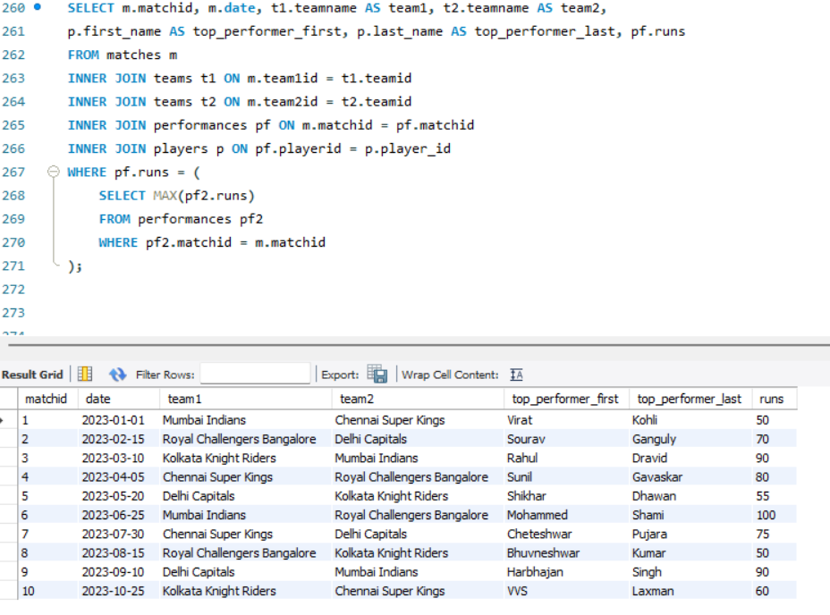
JOINS
Display matches along with the teams that played and the top performer from each match.
SYANTAX:- SELECT m.matchid, m.date, t1.teamname AS team1, t2.teamname AS team2,
p.first_name AS top_performer_first, p.last_name AS top_performer_last, pf.runs
FROM matches m
INNER JOIN teams t1 ON m.team1id = t1.teamid
INNER JOIN teams t2 ON m.team2id = t2.teamid
INNER JOIN performances pf ON m.matchid = pf.matchid
INNER JOIN players p ON pf.playerid = p.player_id
WHERE pf.runs = (SELECT MAX(pf2.runs)
FROM performances pf2
WHERE pf2.matchid = m.matchid);

Slide 24
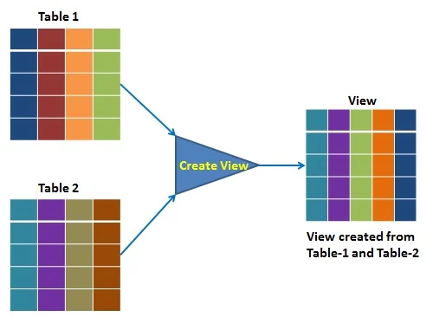
VIEW

Slide 25
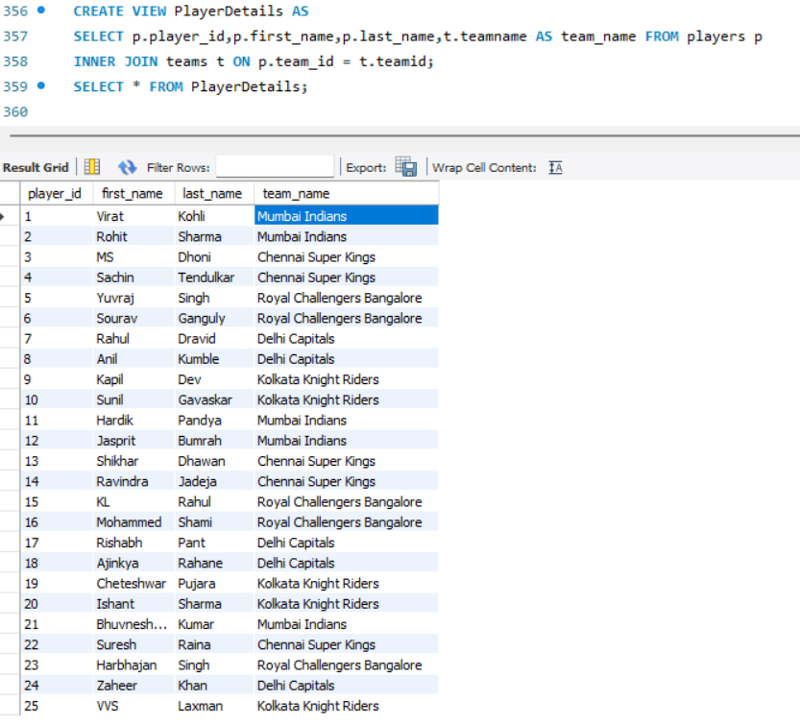
VIEW
Display all players along with the names of the teams they belong to.
SYANTAX:- CREATE VIEW PlayerDetails AS
SELECT
p.player_id,
p.first_name,
p.last_name,
t.teamname AS team_name
FROM
players p
INNER JOIN
teams t ON p.team_id = t.teamid;

Slide 26
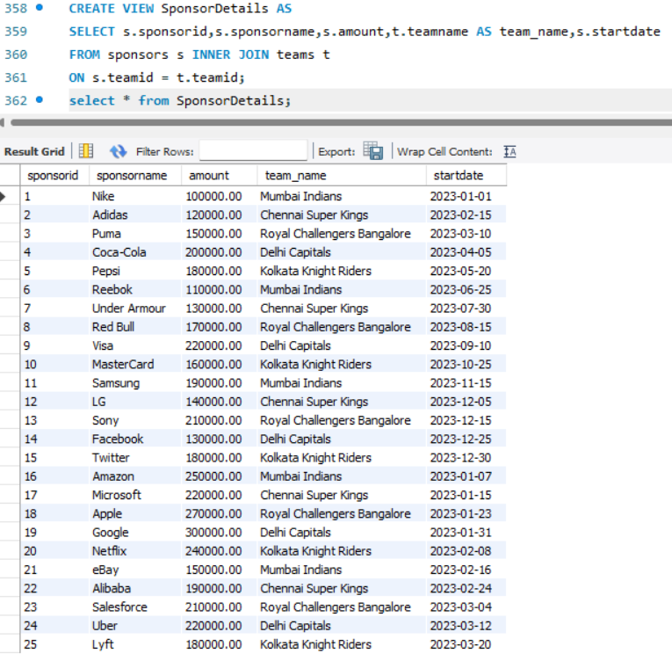
VIEW
Display all sponsors along with the names of the teams they are sponsoring.
SYANTAX:- CREATE VIEW SponsorDetails AS
SELECT
s.sponsorid,
s.sponsorname,
s.amount,
t.teamname AS team_name,
s.startdate
FROM
sponsors s
INNER JOIN
teams t ON s.teamid = t.teamid;

Slide 27
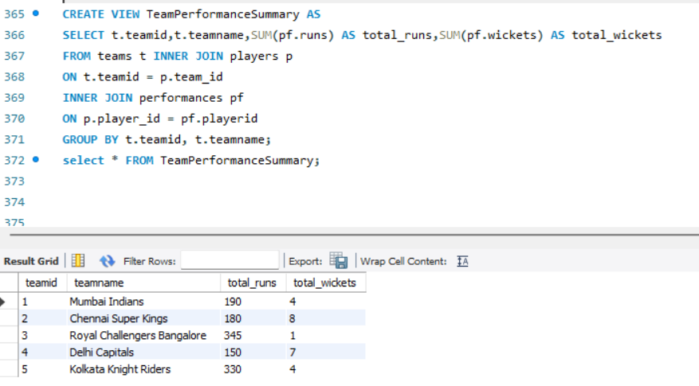
VIEW
Display summary of each team's performance by calculating the total runs and wickets by players in each team across all matches.
SYANTAX:- CREATE VIEW TeamPerformanceSummary AS
SELECT
t.teamid,
t.teamname,
SUM(pf.runs) AS total_runs,
SUM(pf.wickets) AS total_wickets
FROM
teams t
INNER JOIN
players p ON t.teamid = p.team_id
INNER JOIN
performances pf ON p.player_id = pf.playerid
GROUP BY
t.teamid, t.teamname;

Slide 28

PREPARED BY :
OMKAR KADAM
IT VEDANT
Thursday, August 1, 2024

Slide 29

THANK YOU

